Slide 1
Hand Gesture Recognation

Slide 2
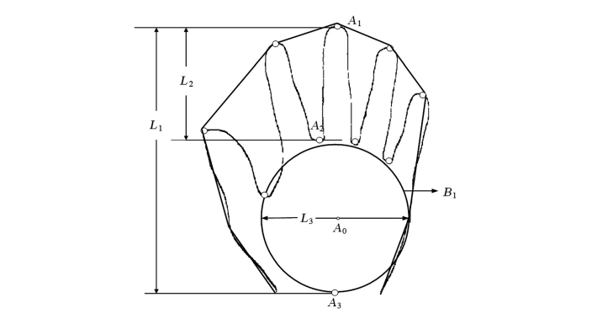

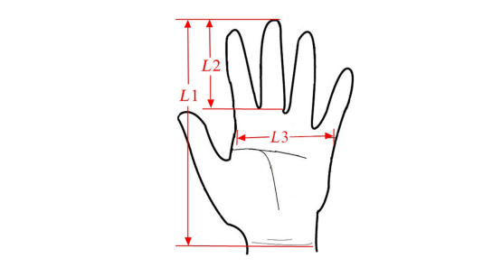
Algorithm

Slide 3
